Slide 1
INTELLIGENT DYNAMICS
INVESTOR PRESENTATION
OUR AMBITION
Robust Solutions Despite Constraints.
VOICE / EXPRESSION
Developing high-performance, robust models in data-constrained environments.
But what if we don’t have enough data?
Audio example: audiodynamics.dev
SPEECH / LANGUAGE / EXPRESSION
01 / 16

Slide 2
INTELLIGENT DYNAMICS
PROBLEM
THE PROBLEM
A specialized task with little to no data.
01
02
The data gap.
The execution gap.
Organizations may need robust specific solutions without having the amount of data that standard methods may require.
Methods that rely on massive scale may fall apart when there is little data or very limited computational resources.
Our goal: bring intelligence to a data-constrained environment.
SPEECH / LANGUAGE / EXPRESSION
02 / 16

Slide 3
INTELLIGENT DYNAMICS
PRODUCT + PROGRESS
DEVELOPMENT APPROACH
A solution that solves your problem, not someone else’s.
INPUT
ADAPTATION
APPLICATIONS
Task-specific data.
Training pipeline.
Custom
software
→
→
Process and augment data.
Design a custom training pipeline for your solution.
New model.
IMPLEMENTED
Fine-tuning pipeline + Jeju text-to-speech system
DEMONSTRATED
Recorded song and dialogue dubbing studies
SPEECH / LANGUAGE / EXPRESSION
03 / 16

Slide 4
INTELLIGENT DYNAMICS
TARGET CUSTOMERS
TARGET CUSTOMER PROFILES
Why not use another solution?
OTHER SOLUTIONS
IN-HOUSE TRAINING
Cost and efficiency.
Why not train ourselves?
It can be inefficient to use someone else’s solutions to your problem. For example, our extremism classifier targets lower-cost, task-specific inference.
Training in a data-constrained environment is a very particular domain. Methods such as adversarial weight perturbation need task-specific adaptation and validation.
Commercial priority: validate the strongest initial customer segment.
SPEECH / LANGUAGE / EXPRESSION
04 / 16

Slide 5
INTELLIGENT DYNAMICS
TARGET CUSTOMERS
TARGET CUSTOMER PROFILES
Our target customer is
B2B / ORGANIZATIONS
B2C / INDIVIDUALS
Someone whose needs are not met.
Someone with little data.
Perhaps their current approach is too expensive, not performant enough, or not efficient enough.
They might work in a data-constrained environment, such as health care.
Commercial priority: validate the strongest initial customer segment.
SPEECH / LANGUAGE / EXPRESSION
05 / 16

Slide 6
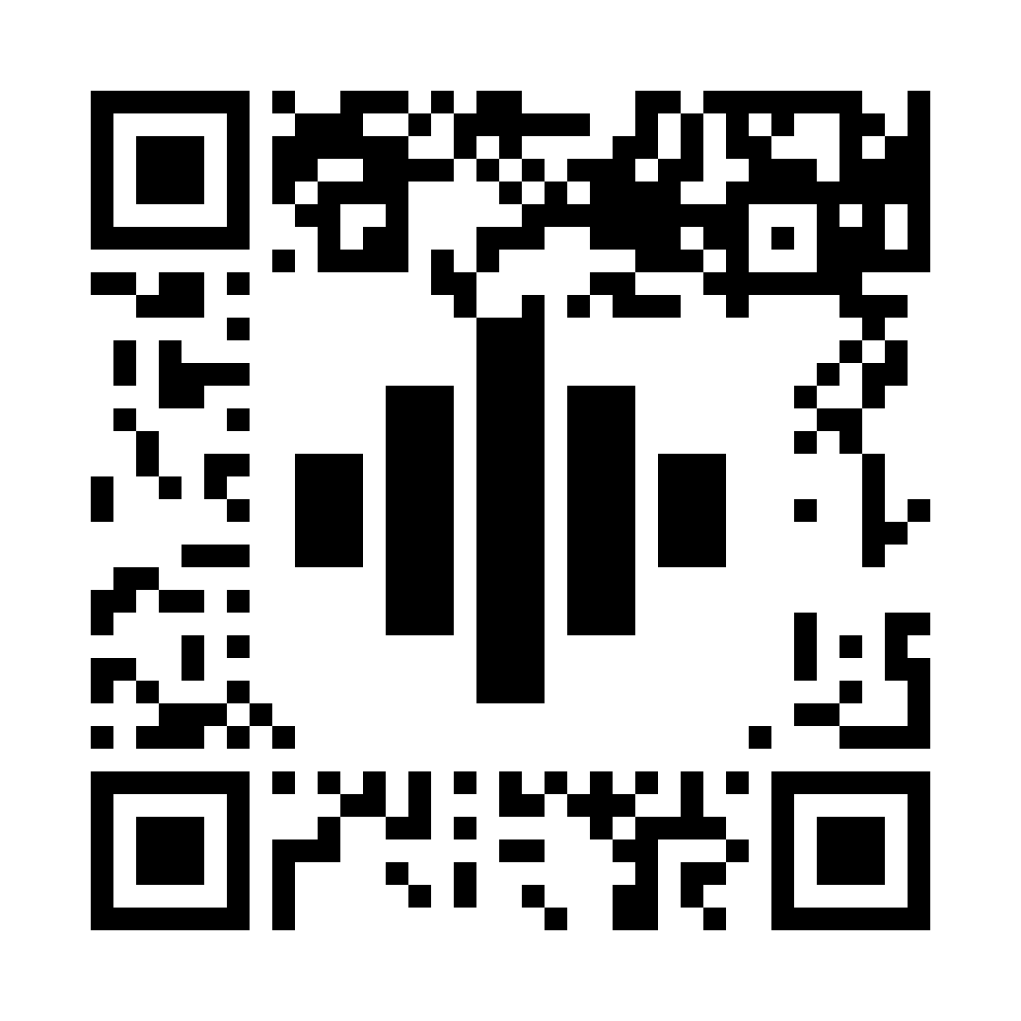
INTELLIGENT DYNAMICS
THE AMBITION
Let’s take a look at some of our solutions.
EXPLORE THE DEMOS
You can view a folder of our audio examples here.
audiodynamics.dev
SCAN TO OPEN
SPEECH / LANGUAGE / EXPRESSION
06 / 16

Slide 7
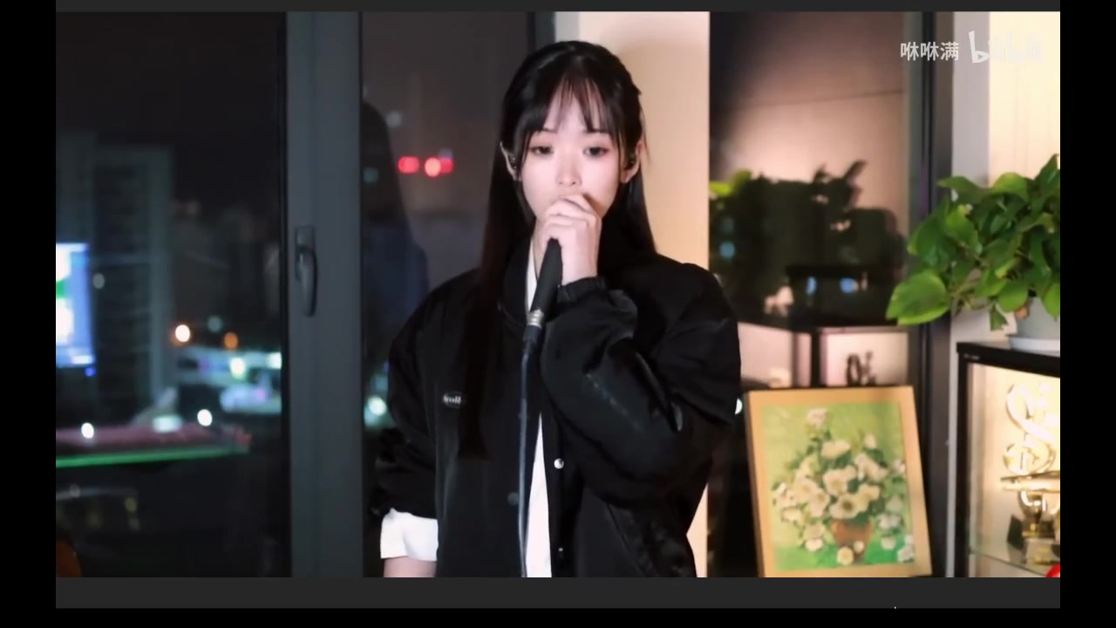
INTELLIGENT DYNAMICS
DEMO / 01
RECORDED PERFORMANCE STUDY
One song. Two languages.
CHINESE → ENGLISH
00:28
Original
Chinese
00:58
Generated
English
The challenge: preserving meaning and pacing across languages.
WATCH ONLINE / audiodynamics.dev
07 / 16

Slide 8

INTELLIGENT DYNAMICS
DEMO / 02
RECORDED PERFORMANCE STUDY
One scene. Three performances.
JAPANESE → ENGLISH
01
Original Japanese
Source performance
02
Previous English
Earlier version
03
New English
Experimental audition
Here’s another real world use case.
WATCH ONLINE / audiodynamics.dev
08 / 16

Slide 9
INTELLIGENT DYNAMICS
MARKET SIZE + OPPORTUNITY
EXTERNAL MARKET CONTEXT
A large category.
A narrow entry point.
GLOBAL AI VOICE GENERATORS · SOFTWARE + SERVICES
TARGET OPPORTUNITY
2026 / ESTIMATE
$7.7B
Custom speech
where standard
fit is not enough.
2030 / FORECAST
$21.8B
Specific languages.
Specialized workflows.
Limited task-specific audio.
Category estimates, not our serviceable market or revenue forecast.
Source: Grand View Research, AI Voice Generators Market (2024–2030) · accessed 15 Sep 2026
SPEECH / LANGUAGE / EXPRESSION
09 / 16

Slide 10
INTELLIGENT DYNAMICS
COMPETITIVE LANDSCAPE
SELECTED ALTERNATIVES
Audio is a crowded field, but we believe our solutions are robust.
ALTERNATIVE
Documented capability.
Goals to validate.
ElevenLabs
Multilingual dubbing; speaker
identity and emotional tone.
Live and on-device performance.
Microsoft
Azure Speech
Custom speech recognition
and custom synthetic voices.
Highly expressive audio.
OpenVoice
Short-reference voice cloning
and cross-language style control.
Control and performance.
Our test to win: less task-specific data at matched quality.
Sources below; vendor-reported capabilities, not head-to-head results.
ElevenLabs
Microsoft: recognition
Microsoft: voice
OpenVoice
Reviewed 15 Sep 2026
SPEECH / LANGUAGE / EXPRESSION
10 / 16

Slide 11
INTELLIGENT DYNAMICS
UNIQUE ADVANTAGE / MOAT THESIS
MOAT THESIS
From custom models
to cumulative know-how.
BUILT
TO VALIDATE
POTENTIAL TO COMPOUND
Adaptation
capability
Training-data
efficiency
Reusable
methods
Fine-tuning pipeline
and Jeju text-to-speech
development.
Fewer task-specific
recordings at the same
quality level.
Carry useful adaptation
methods into the next
language or workflow.
SPEECH / LANGUAGE / EXPRESSION
11 / 16

Slide 12
INTELLIGENT DYNAMICS
BUSINESS-MODEL DESIGN
COMMERCIAL MODEL
Custom scope.
Recurring access.
B2B / CUSTOM PROJECTS
B2C / SUBSCRIPTION + USAGE
Project revenue
Recurring access
Pricing reflects the language,
workflow and scope of the
custom speech solution.
Subscriptions and pay-as-you-go
fees give consumers access
to speech tools.
Next commercial proof: a priority buyer, willingness to pay and delivery economics.
SPEECH / LANGUAGE / EXPRESSION
12 / 16

Slide 13
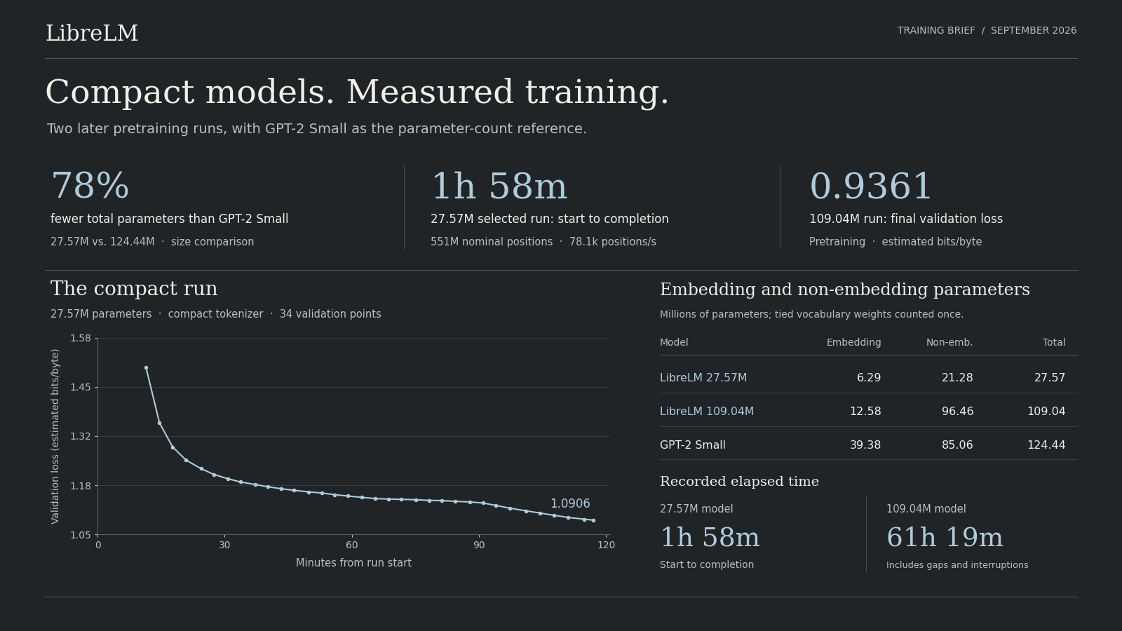
INTELLIGENT DYNAMICS
PIPELINE REUSE
We are also quite experienced with natural language processing.
Let’s attempt to create a language model from scratch.
Since I did, this mostly just for fun and trained on my laptop 100 million parameter, 60 hour estimate is wrong. I actually paused the training run several times so I could play video games or do other stuff.
SPEECH / LANGUAGE / EXPRESSION
13 / 16

Slide 14


INTELLIGENT DYNAMICS
PIPELINE REUSE
What about computer vision?
Let’s do something no one’s done before.
There are two models. First is an image decomposition model which decomposes existing images into valid Photoshop sequences. The second takes textual prompt and creates novel sequences to create a novel image.
SPEECH / LANGUAGE / EXPRESSION
13.5 / 16

Slide 15
INTELLIGENT DYNAMICS
TEAM BACKGROUND
THE FOUNDERS
Research depth. Hands-on execution.
Oskar Jonientz
Andrew
CO-FOUNDER
CO-FOUNDER / UCLA COMPUTER SCIENCE
Model engineering
Published AI researcher
Built a hybrid Mamba–Transformer
masked-diffusion model in PyTorch.
Worked with Georgetown professors on
agentic ML for high-dimensional biomedical data.
Customer-facing software
Language models + retrieval
Built and sold software; supported users
and incorporated product feedback.
Experience building and evaluating
language-model and retrieval systems.
Cross-team execution
ML pipelines + evaluation
Boeing internship, summer 2024: business
case development and technical proposals.
Python-based machine-learning pipelines
and rigorous model-performance testing.
SPEECH / LANGUAGE / EXPRESSION
14 / 16

Slide 16
INTELLIGENT DYNAMICS
DEVELOPMENT STAGES
PROPOSED PROOF POINTS
Make it work.
Then make it repeatable.
01
02
03
Measure
Validate
Repeat
Compare data required at
matched quality against
named baselines.
Test a specific buyer’s
workflow, budget and
acceptance criteria.
Reuse what works; measure
delivery cost and
repeat demand.
Quality evidence first. Commercial evidence next.
SPEECH / LANGUAGE / EXPRESSION
15 / 16

Slide 17
INTELLIGENT DYNAMICS
THE AMBITION
Audio Examples
EXPLORE THE DEMOS
You can view a folder of our audio examples here.
audiodynamics.dev
SCAN TO OPEN
OSKAR JONIENTZ / CO-FOUNDER
oskarjonientz@gmail.com
SPEECH / LANGUAGE / EXPRESSION
16 / 16

